Slide 1
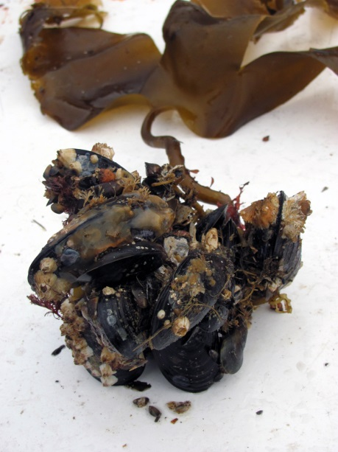

Slide 2
Transect/ depth, m | R (N) | BS (S) | BN (N) | SS (S) | SN (N) | MidN (N) | MoS (S) | MoN (N)
+2 |  | 05, 09 | 05, 09 |  | 10 | 04, 09 |  | 04, 10
+1.5 |  | 03*, 04, 09 | 05, 09 | 10 | 10 | 04, 09 | 04, 09 | 04, 10
+1 |  | 04, 09 | 05, 09 | 10 | 10 | 04, 09 | 04, 09 | 04, 10
+0.5 | 05, 09 | 04*, 09, 10, 12*, 18* | 05, 09 | 05, 10 | 10 | 04, 09, 12*, 18* | 04, 05*, 09, 12*, 18* | 04*, 10
-0.5 |  | 04, 09 | 09 | 10 | 10 | 09 | 09 | 10
-1.5 |  | 04, 09, 18* |  | 10 | 10 | 09, 12*, 18* | 09, 12*, 18* | 10
-3.5 |  |  |  |  | 10 | 09
Transect/ depth, m | R (N) | BS (S) | BN (N) | SS (S) | SN (N) | MidN (N) | MoS (S) | MoN (N)
+2 |  | 05, 09 | 05, 09 |  | 10 | 04, 09 |  | 04, 10
+1.5 |  | 03*, 04, 09 | 05, 09 | 10 | 10 | 04, 09 | 04, 09 | 04, 10
+1 |  | 04, 09 | 05, 09 | 10 | 10 | 04, 09 | 04, 09 | 04, 10
+0.5 | 05, 09 | 04*, 09, 10, 12*, 18* | 05, 09 | 05, 10 | 10 | 04, 09, 12*, 18* | 04, 05*, 09, 12*, 18* | 04*, 10
-0.5 |  | 04, 09 | 09 | 10 | 10 | 09 | 09 | 10
-1.5 |  | 04, 09, 18* |  | 10 | 10 | 09, 12*, 18* | 09, 12*, 18* | 10
-3.5 |  |  |  |  | 10 | 09

Slide 3
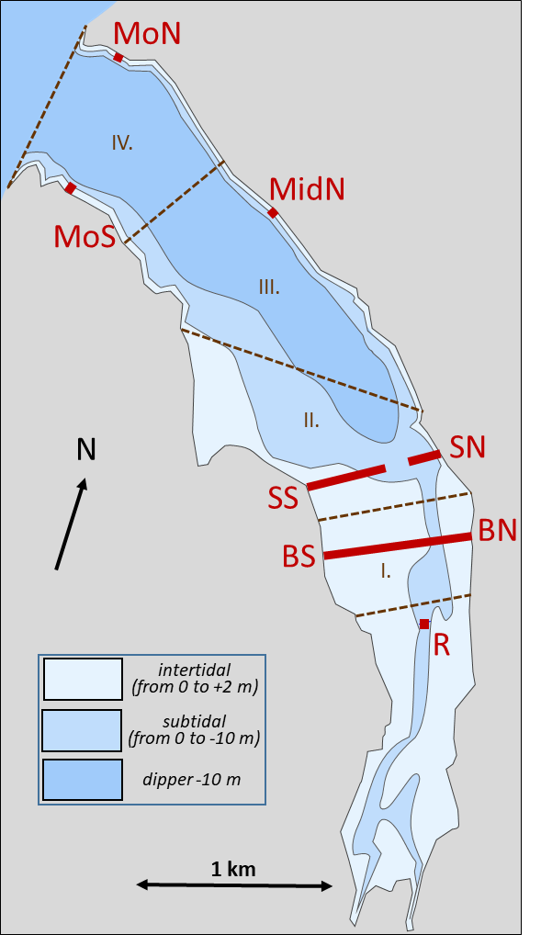
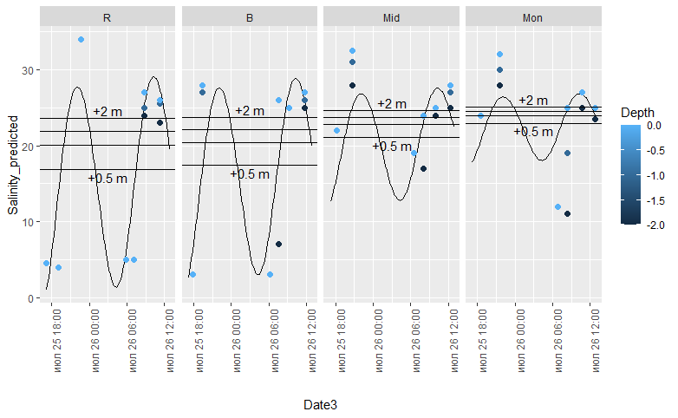
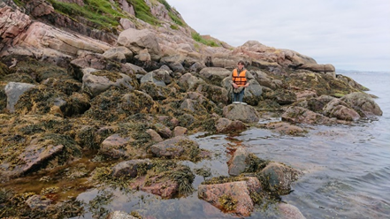
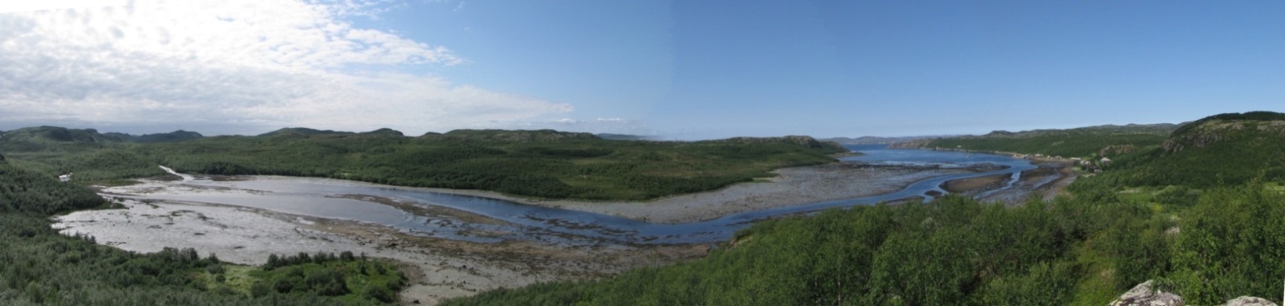
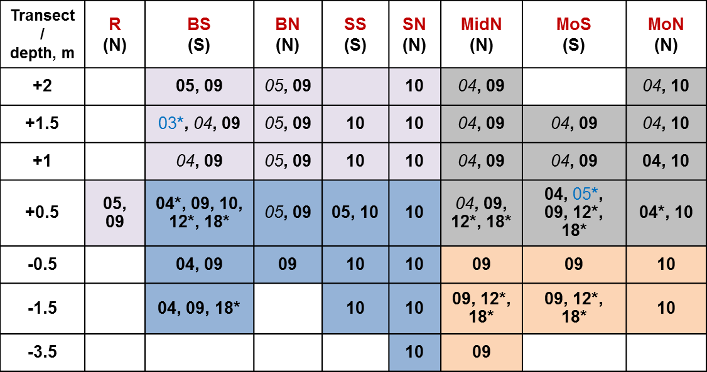
1 km
Кусок кольского берега, соответствующий местам историч. сборов
Линии можно подписать, для точек которые какая-то глубина просто показать это значками
Mos +1
Mos +1
С.
MidN
BS
R
MidN -1.5

Slide 4
Figure 1. Tyuva Inlet and its mussels. (a) Polar view map of Arctic Ocean. Box indicates the location of Kola Bay. (b) Map of Kola Bay and surroundings. Box indicates location of Tyuva Inlet. (c) Map of Tyuva Inlet. The littoral and upper sublittoral (<10 m) zones are depicted in different shades of ?blue. Red lines and abbreviated names denotes transects along which the mussels were sampled in 2003-2018. Numbered figures with dashed borders denote the Inlet divisions over which mussel abundance estimates were averaged in calculations of total abundance. Stars indicate points of salinity assessments. (d) Spatial and temporal variation of salinity, ppt, in the Tyuva littoral in 25-26 July 2009. Reconstructed average? overall? salinity (curve), mean values for different horizons (horizontal lineages) and empirical data (points, color reflecting depth of sampling, see the legend) in the four studied locations of the Inlet, labeled as in Fig. 1c are presented.
(e-h). Tyuva mussels and their habitats (была мысль перенести в приложение, “ESM Fig. ? с фотками”.м.б. оставив панораму. Top of the Inlet by low water. Intertidal flats are visible. The distance between R05 and BS05 is ? km and between BS05 and MidS is ?? km. Туда же исторические иллюстрации!). Abbreviated names reflect transects or sampling localities, as in i. All photos were taken in ?2009. (?) Top of the Inlet by low water. Intertidal flats are visible. (?) Thallus of sublittoral Alaria esculenta with its substrate and attached mussels. (?) Mussel bed. (?) Rocky littoral. (i) Locations and years of mussel surveys in Tuva 2003-2018. Columns are transects, notations as in c; N and S denotes the coast. The lines are depth horizons from the chart datum (negative values denote sublittoral position). Numbers are years of studies (03 - 2003, 04 - 2004, etc.). Blue font and asterisks indicate years of sample collection for genetics, black font for demography, and bold for taxonomic structure by morphotypes. Cell filling reflects mussel habitat. ?Pink- littoral sandbanks, ?orange– sublittoral kelp forests, ?gray - rocky littoral, ?blue - mussel bed habitat. (Это можно сделать и отдельной таблицей, тогда как заливку клеток (местообитания) делать?

Slide 5
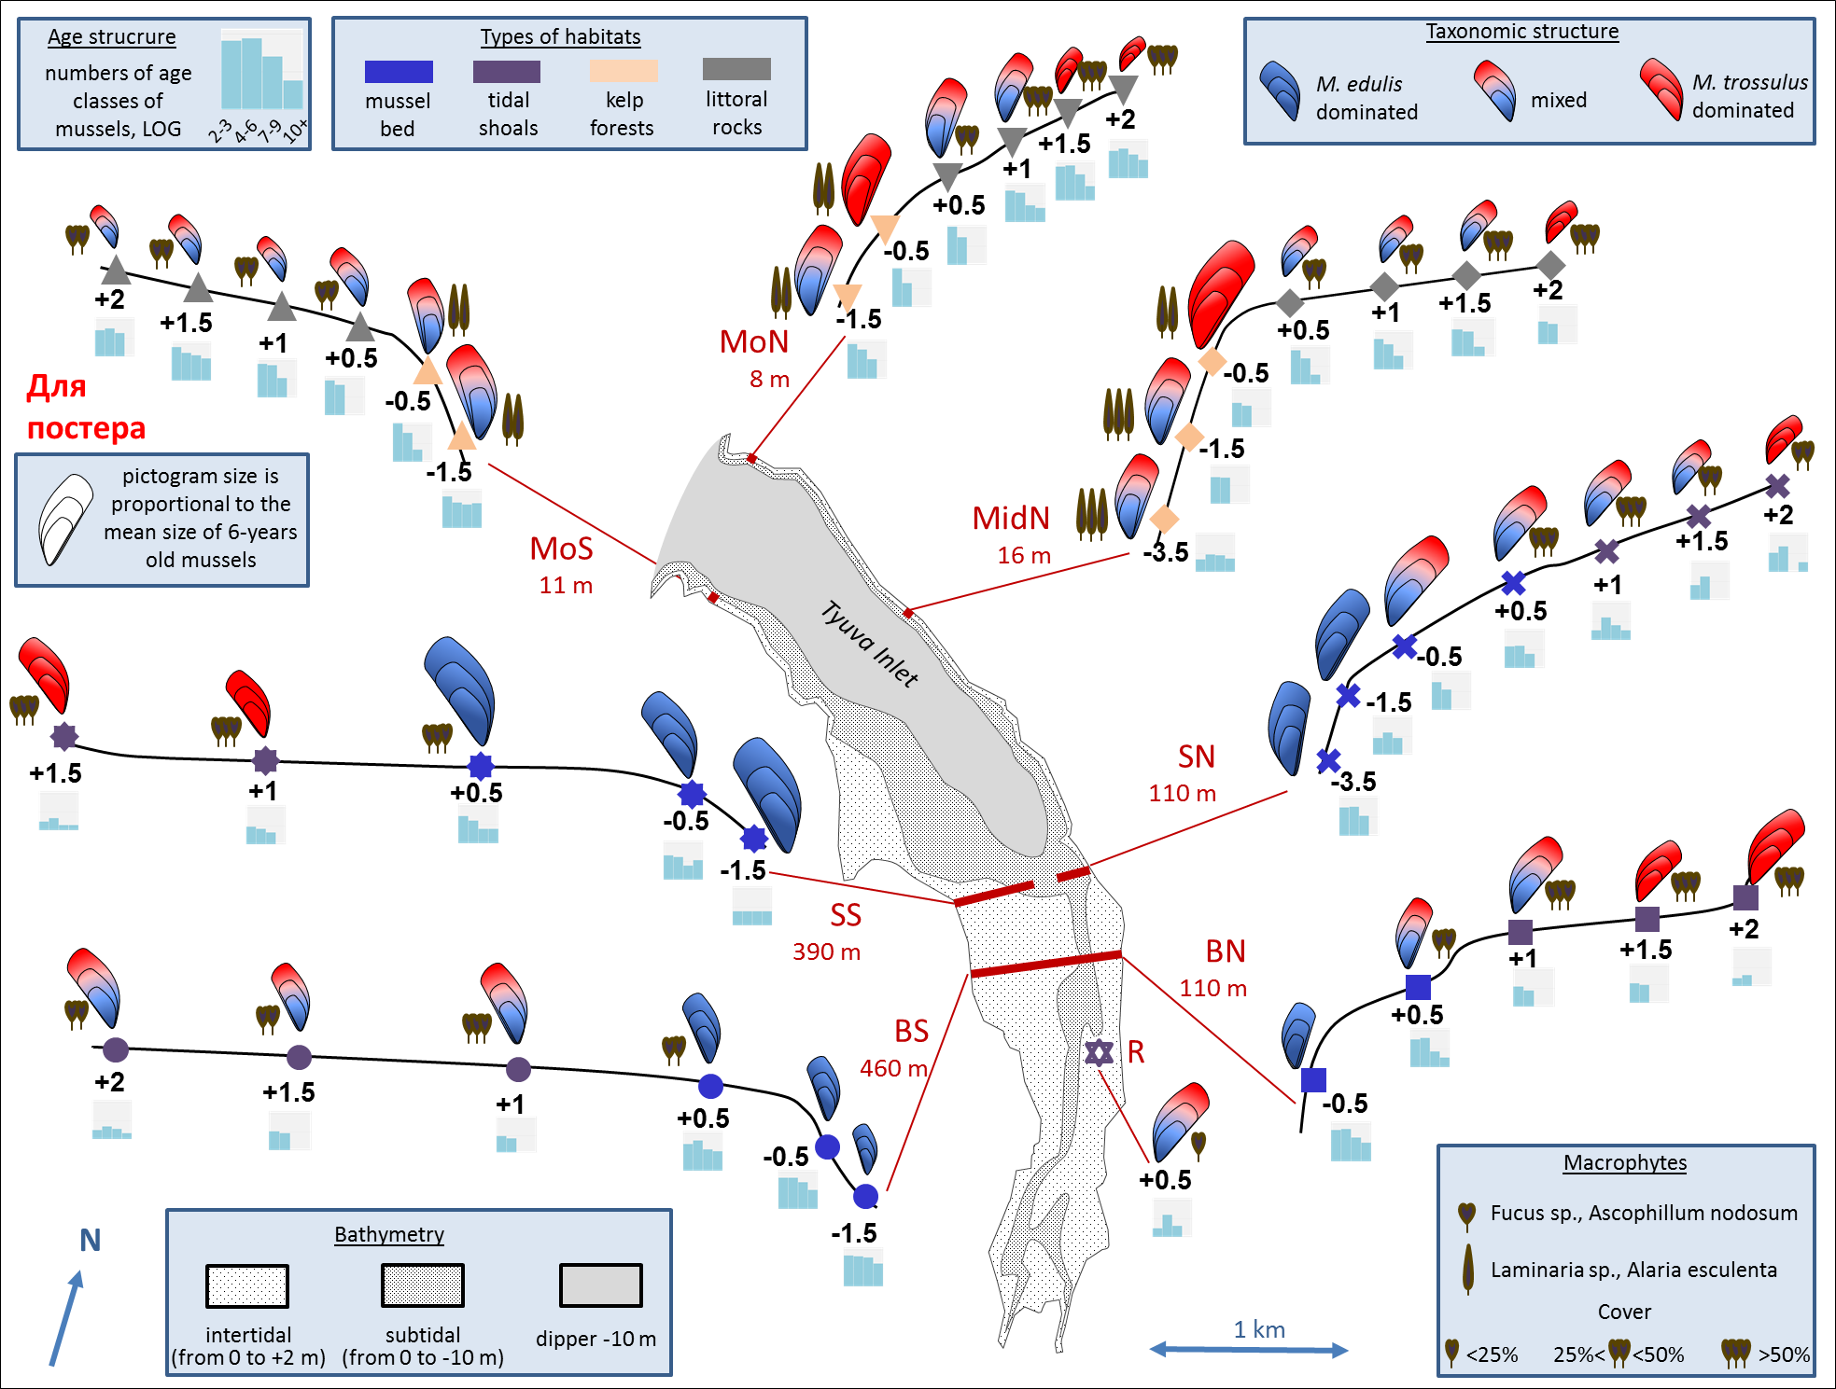



Characteristics of mussel settlements in Tyuva Inlet in 2009-2010. Schematically given profiles of the transects where mussels were sampled (note that the width of different transects are given in different scales, due to the very different steepness of the shore – рядом с профилями указать масштаб). The dots are the studied settlements, the depths in meters from the chart datum are indicated. The color of the dots reflects the habitat type, the algae icons represent the dominant species and their cover abundance, as indicated in the legend. The size of mussel pictograms is proportional to the average size of mussels at the age of 6x years, and the smaller and larger "annual rings" - to the sizes at the age of 2 and 4 years, respectively. The color filling reflects the ratio of M. trossulus (red) and M. edulis (blue) among mussels 4-7 years old. Histograms - age structures, the logarithms of the average density of mussels of different age groups per square meter are given (see legend). Other notations are as in Fig. 1c.
Годовые кольца надо нарисовать, чтобы это хоть как-нибудь ассоциировалось с OGP. Повторяю: «средних» размеров мидий в анализах нет, сами по себе они только здесь всплывают.
Гистограммы плохо читаются. Крупнее и должна быть четкая «шкала» рамка/заливка, и легенда объясняющая величины на оси ОУ
Я уже не помню почему оставили три типа таксономич. структуры/заливки, лучше бы непрерывно
100000
1000
10
2-3
4-6
7-9
10+

Slide 6
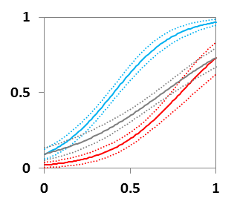
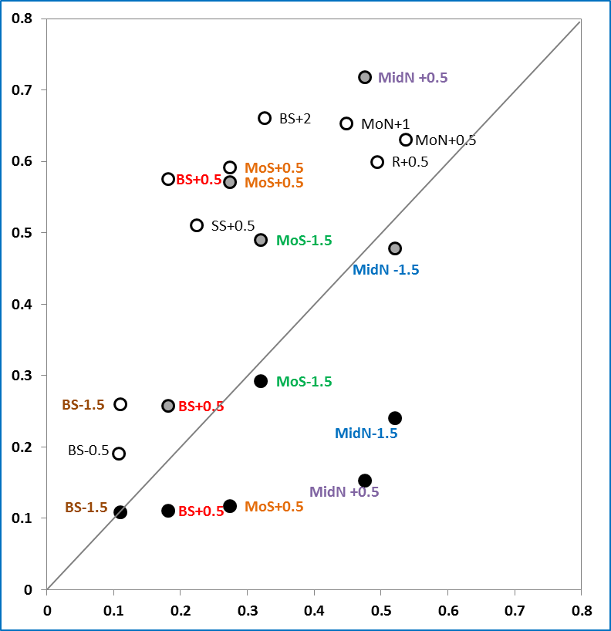
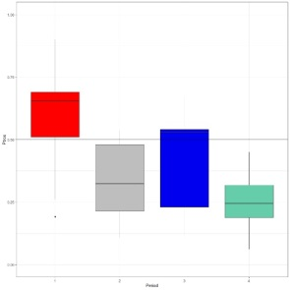
2003-2005
2012
2018
2004-2005
2012
2018
Под цвет точек

Slide 7
???
A. Dependence of proportion of M. trossulus genotypes (Ptros) on proportion of T-morphotypes (PT) in samples from Tyuva. Dots are empirical estimates, color reflects the period of sampling (see the legend). Sampling localities are labeled as in Fig.?, repeated samples from the same localities are highlighted in font color. Solid line is regression model predictions, dashed lines – boundaries of 95% confidence interval of regression. The same regression is shown in the insert together with corresponding regressions for samples from low-saline (<30 ppt; blue) and high-saline (>30 ppt; Tyuva samples not considered; red line) localities in the Barents Sea from the study of Khaitov et al. 2021.
B. Frequencies of M. trossulus predicted from morphotypes in different temporal samples from the same settlements. All settlements were studied in 2009-10 (predicted Ptros in these samples are plotted on the horizontal axis) and at one or more other points in time (vertical axis; see the legend). The rest of the notations are as in (A). If the predicted Ptros in settlements did not change over time, the dots would lie on the diagonal. Note that all of the dashed points lie above the diagonal (compared to 2009-10, Ptros in 2004-05 was higher) and all but one of the black points lie below the diagonal (compared to 2009-10, Ptros in 2018 was lower). That is, predicted Ptros declined universally in both of these time periods. The insert shows box-whisker plots representing the frequency distributions of predicted Ptros in the samples, from left to right, from 2004-2005, 2009-2010, 2012, and 2018.

Slide 8
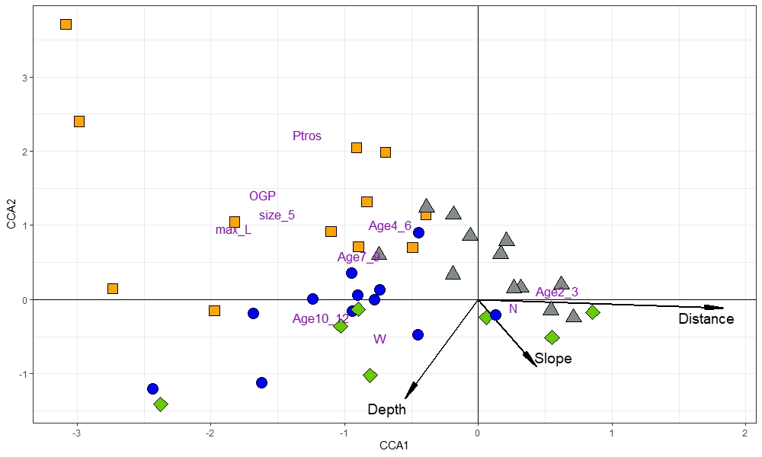
Fig. Symmetrically scaled canonical correspondence analysis (CCA) of mussel settlements described in terms of demographic and taxonomic parameters in 2009-2010. CCA1 explains 36.5%, CCA2 - 9.6 % of the total inertia. Each sign represent mussel settlement, settlements from the kelp forests, rocky littoral, sandbanks, and from the mussel bank are shown with signs of different form and color. Text markers represent demographic and taxonomic parameters. Arrows indicate environmental constrains (direction and length of arrows shows the degree of association between canonical axes and environmental constrains).
Если CA решили не красить по местообитаниям, а показывать формой, то и здесь не красить

Slide 9
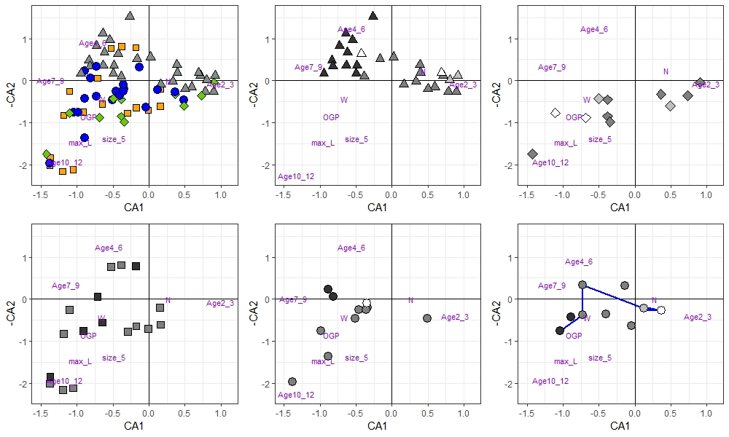
Fig. Correspondence Analysis (CA) plot based on demographic characteristics of mussel settlements in all surveys (data for the same settlements for different years are considered independently). CA1 explains ??%, CA2 - ??% of variance. (A) Original plot, signs are settlements, settlements from different habitats are depicted as on Fig. ?; ordination of demographic characteristics is shown by abbreviated names. B-F. Graphs identical to that on (A), but some of the points are hidden to show temporal changes in the settlements from certain habitats (B – Rocky littoral, C - Kelp forests, D – littoral sandbanks, E – sublittoral part of mussel bed, F - littoral part of mussel bed). The intensity of the color fill reflects the time period of sampling. The arrows on ?. show temporal changes in BS+05 studied in 2005, 2009, 2010, 2012, and 2018.
График д.б. один, почему от нрафика к графику ползают демографические параметры?
Что-то надо делать с цветовой кодировкой; м.б. на «А» убрать цвет, заменив его цветом линии маркера, который сохранять на других графиках?
При написании результатов может выясниться, что стрелки нужны для других неоднократно изученных точек

Slide 10
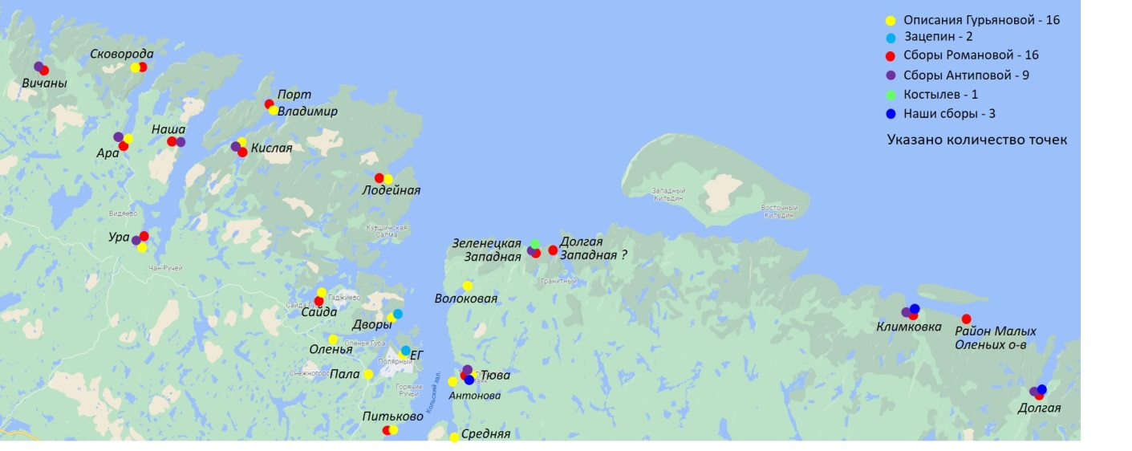
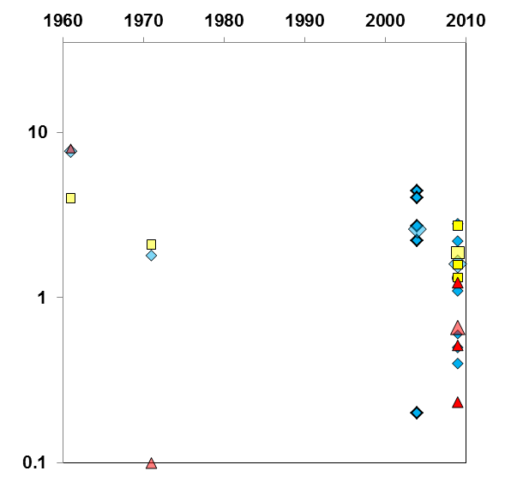
Long-term dynamics of mussels in the Kola Bay and vicinity, according to REFS and our data. (a) Map of historical mussel survey sites. Sites are marked with signs and abbreviated names (Tv - Tuva Bay, Km - Klimkovka Bay, ZZ - Zelenetskaya Zapadnaya, DL - Dolgaya Bay, etc., see legend and ESM for details). (b, c) Abundance of mussels at different sites in different years. Only data where biomasses were estimated by presumably comparable methods on vertical transects through the mussel-inhabited littoral zone are considered. Average logarithmic values of biomass are presented. (b) Estimates of mussel biomass in Tyuva (blue), Klimkovka (yellow) and Dolga (red) in different years. For the 2004 and 2009 surveys, small icons indicate data for individual transects, and large icons indicate data averaged over all transects. (c) Estimates of mussel biomass from all study sites (signs; left vertical axis). Individual transect data from the same locations are averaged. White signs represent single survey points, gray signs represent double survey points, and colored signs represent multiple survey points as in map (a). The curve line is the average annual SST values in the Kola hydrological section, according to PINRO data (REF), averaged over five years including the four preceding years. Temperature is along the right vertical axis.

